Slide 1
Chapter 4 Engine and Refrigerators
Heat Engine – Carnot Cycle
Refrigerator
Real Heat Engine

Slide 2
Heat Engine
Any device that absorbs heat and converts a part of that energy into work
Internal combustion engine used in most of today’s automobiles , does not actually absorb heat, but we can pretend that the thermal energy comes from outside rather than inside and treat it, also, as a heat engine
Examples:
Steam turbines generates electricity in most of power plants
Ideal heat source: It gives away heat, but its temp does not change
Heat Source or Hot reservoir
T_{h}
Ideal heat sink: It absorbs heat, but its temp does not change
Q_{h}
W
If Q_{h} is the heat in at T_{h}
Q_{c} is heat dumped at T_{c}
The work
Q_{c}
$$W=Q_{h}−Q_{c}$$
T_{c}
Heat Sink or Cold reservoir
Efficiency
$$e≡\frac{Benefit}{Cost}=\frac{W}{Q_{h}}$$
$$e=\frac{Q_{h}−Q_{c}}{Q_{h}}$$
$$e=1−\frac{Q_{c}}{Q_{h}}$$
$$<100\%$$

Slide 3
Heat Engine cont…
As heat flows into the engine, it brings entropy also that must be disposed off before the cycle of the engine starts over again
To get rid of the entropy, every heat engine must dump some waste heat into heat sink (environment)
The heat reservoir is giving away heat, Q_{h}
Its entropy , $\frac{Qh}{T_{h}}$ must decrease
while the cold reservoir absorbs the heat, Q_{c}
Its entropy , $\frac{Q_{c}}{T_{c}}$ must increase
2nd Law ➔ The total change in the entropy of engine plus surrounding $≥0$
$$∆S_{total}=∆S_{c}−∆S_{h}≥0$$
Therefore,
$$∆S_{total}=\frac{Q_{c}}{T_{c}}−\frac{Q_{h}}{T_{h}}≥0$$
$$e=1−\frac{Q_{c}}{Q_{h}}$$
$$\frac{Q_{c}}{T_{c}}≥\frac{Q_{h}}{T_{h}}$$
$$e≤1−\frac{T_{c}}{T_{h}}$$

Slide 4
1st Law ➔ you can not have an efficiency more than 100 %
Since energy must be conserved
2nd Law makes things even worse
➔ you can not even have an efficiency equals to100 %
As you can not have
$T_{h}→∞$ or $T_{c}→0 K$
A Carnot Cycle (engine) is an ideal heat engine with maximum efficiency
In many engine the work substance is gas
1st gas absorbs heat Q_{h} from heat reservoir
$$∆S_{h}=−\frac{Q_{h}}{T_{h}}$$
➔ Entropy of heat reservoir decreases
$$∆S_{gas 1}=\frac{Q_{h}}{T_{gas 2}}$$
But entropy of gas increases
$T_{gas1 }$will be little less than T_{h}
Next T_{gas1} remains constant by allowing gas to expand isothermally
2nd when gas dumps waste heat to cold reservoir, $∆S_{c}$ increases
➔ $∆S_{gas 2}=−\frac{Q_{c}}{T_{gas 2}}$
T_{gas2} will be little higher than T_{c}
Again, T_{gas2} remains constant at this temp by isothermal compression

Slide 5
Therefore, we have
Isothermal expansion
at temperature of gas that is little less than hot reservoir temperature
and
Isothermal Compression
at temperature of gas that is little higher than cold reservoir temperature
This will avoid creating any new entropy
The remaining part is/are
How to get gas at one temperature to another and back?
To avoid any leakage of heat during these steps, these steps must be
Adiabatic
Entire Cycle of an ideal heat engine
Isothermal expansion at $T≈T_{h}$
Adiabatic expansion (so that T decreases from T_{h} to T_{c})
Isothermal compression at $T≈T_{c}$
Adiabatic compression (so that T increases from T_{c} to T_{h})

Slide 6
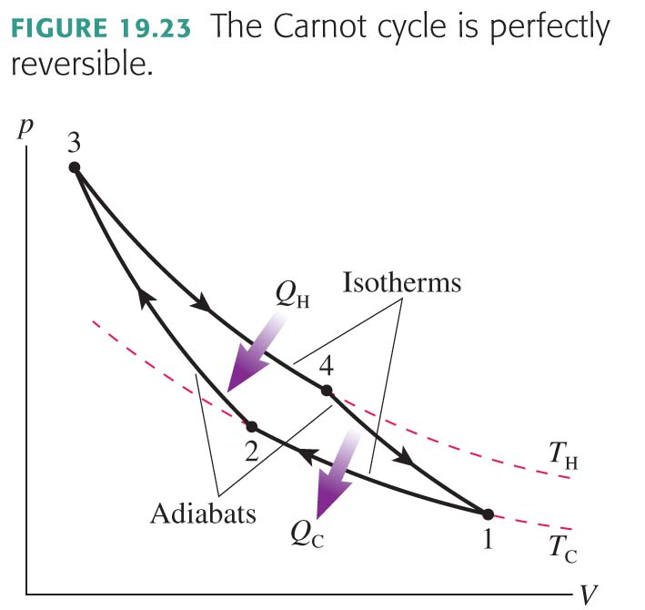
The Carnot Cycle
The gas is isothermally compressed at T_{C}. Heat energy Q_{C} = |Q₁₂| is removed.
The gas is adiabatically compressed, with Q = 0, until the gas temperature reaches T_{H}.
After reaching maximum compression, the gas expands isothermally at temperature T_{H}. Heat Q_{H} = Q₃₄ is transferred into the gas.
The gas expands adiabatically, with Q=0, until the temperature decreases back to T_{C}.
Work is done in all four processes of the Carnot cycle, but heat is transferred only during the two isothermal processes.

Slide 7
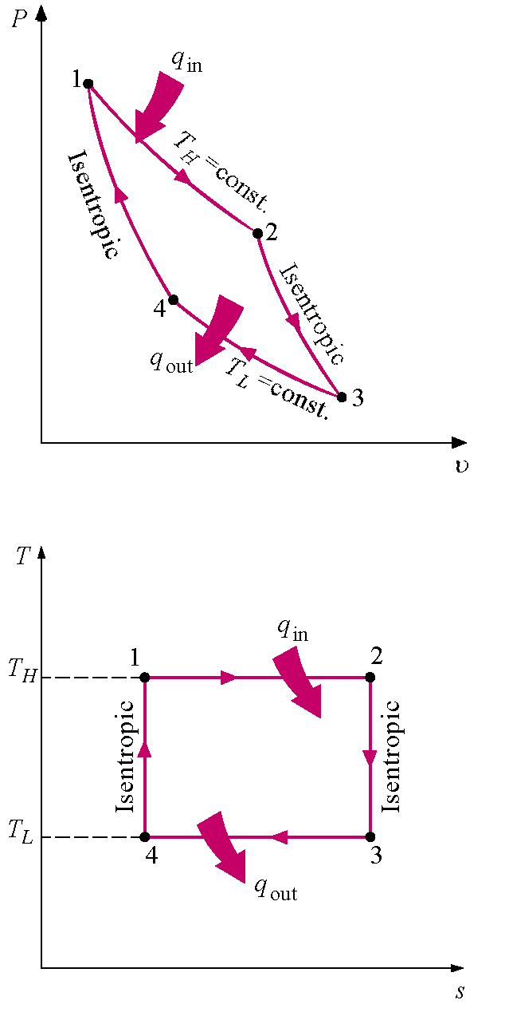
Carnot Cycle
The Carnot cycle is the most efficient thermodynamic cycle for operating a heat engine.
It is a reversible cycle, that consists of two isotherms and two adiabats.
Process Description
1-2 Isothermal heat addition
2-3 Isentropic expansion
3-4 Isothermal heat rejection
4-1 Isentropic compression
Adiabatic and quasistatic
Thermodynamics: An Engineering Approach, 5th edition by Yunus A. Çengel and Michael A. Boles

Slide 8
The Carnot Cycle

Slide 9
Third Law of Thermodynamics
The 3rd law states that as the temperature goes to zero, the entropy goes to a constant, S_{o}
It is impossible to reach a temperature of absolute zero.
It is impossible to have a (Carnot) efficiency equal to 100% (this would imply T_{c} = 0).

Slide 10
Example
An ideal gas is taken through the Carnot cycle. The isothermal expansion occurs at 250 ºC, and the isothermal compression takes place at 50 ºC. The gas takes in 1200 J of energy from the hot reservoir during the isothermal expansion. Find
the energy expelled to the cold reservoir in each cycle and
the net work done by the gas in each cycle.
$$η=\frac{W_{out}}{1200 J}$$
W_{out} = 459 J
$T_{H}$= 250ºC = 523 K
$T_{C}$= 50ºC=323 K
$Q_{H}$= 1200 J
$$η=1−\frac{Q_{C}}{Q_{H}}$$
Q_{C} = 741 J
$η=1−\frac{T_{C}}{T_{H}}$ = 0.382

Slide 11
Example
One of the most efficient heat engines ever built is a steam turbine in the Ohio valley, operating between 430 ºC and 1870 ºC on energy from West Virginia coal to produce electricity for the Midwest.
What is the maximum theoretical efficiency (the Carnot efficiency)?
The actual efficiency of the engine is 42%. How much useful power does the engine deliver if it takes in 1.4 × 10⁵ J of energy each second from its hot reservoir?
$T_{C}$ = 430ºC = 703 K
$T_{H}$ = 1870ºC = 2143 K
Q_{H} = 1.4 × 10⁵ J
$$η=0.42=\frac{W_{out}}{QH}$$
W_{out} = 58.8 kJ
$η=1−\frac{T_{C }}{T_{H}}$ = 67.2%

Slide 12
Problem-Solving Strategy: Heat-Engine Problems
Identify each process in the cycle
Visualize
Draw the PV diagram
Solve
There are several steps in the mathematical analysis
Use ideal-gas law to find, n, P, V and T at one point in the cycle.
Use ideal-gas law and equation for specific gas processes to determine P, V and T at the beginning and end of each process.
Calculate Q, W and ΔU.
Find W_{out} by adding the works in all processes. In case of simple geometry, you can confirm this y finding area enclosed within PV curve.
Add just positive values of Q to find Q_{h}.
Verify that Δu_{net} = 0 for a complete cycle.
Calculate the Thermal efficiency, η and any other quantity you need to complete the solution
Assess
Is Δu_{net} = 0, Do all signs of works and heat make sense? Does η has a reasonable value? Have you answered all the questions?

Slide 13
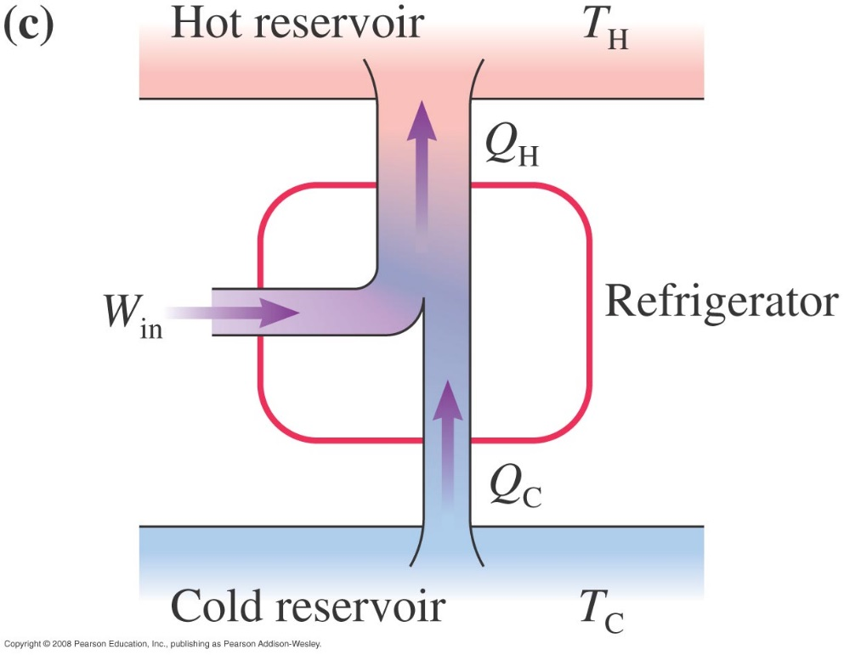
Refrigerators
2nd law - Heat is always transferred spontaneously from a hotter object to a colder object.
Refrigerators
The gas in a refrigerator can extract heat Q_{C} from the cold reservoir only if the gas temperature is lower than the cold-reservoir temperature T_{C}. Heat energy is then transferred from the cold reservoir into the colder gas.
The gas in a refrigerator can exhaust heat Q_{H} to the hot reservoir only if the gas temperature is higher than the hot-reservoir temperature T_{H}. Heat energy is then transferred from the warmer gas into the hot reservoir.
T_{gas} < T_{C}
T_{gas} > T_{H}

Slide 14
Refrigerators
The purpose of a refrigerator is to make thermal energy flow from cold to hot. The coefficient of performance for a fridge:
hot reservoir, T_{H}
heat
entropy
work
heat
COP is the largest when T_{H} and T_{C} are close to each other!
Note: Heat can not be transferred from low temperature to high temperature without doing extra work.
cold reservoir, T_{C}

Slide 15
More on Refrigerators
We can create a refrigerator by running a Carnot engine backwards: the gas extracts heat from the cold reservoir and deposit it in the hot reservoir.
hot reservoir, T_{H}
P
1
rejects
heat
heat
2
entropy
T_{H}
work
4
3
heat
T_{C}
absorbs heat
V
However, it is difficult to built a practical refrigerator using such an ideal gas cycles as Carnot or Stirling. Most modern refrigerators use some liquid as a working substance. These schemes are better than a reversed Carnot cycle: much more energy can be absorbed per unit mass of working substance. Thus, the fridge can be much smaller than a Carnot fridge could be.
cold reservoir, T_{C}

Slide 16
The Maximum Efficiency
COP

Slide 17
Assignment # 6 Due 3/25/2022
4.5, 4.6, 4.14, 4.15 & 4.23.
Problems for practice of Ch 4:
4.1, 4.2, 4.3, 4.4, 4.7, 4.8, 4.9, 4.10, 4.11, 4.18, 4.20 & 4.22.

